Slide 1
Data Pre-processing

Slide 2
Learning Outcomes
Data cleaning
Fill in missing values
Identify outliers and smooth out noisy data
Correct inconsistent data
Data Integration
Data Transformation
Data Reduction and Discretisation

Slide 3
Missing Data
Data is not always available
E.g., many tuples have no recorded value for several attributes, such as customer income in sales data
Missing data may be due to
equipment malfunction
inconsistent with other recorded data and thus deleted
data not entered due to misunderstanding
certain data may not be considered important at the time of entry
no register history or changes of the data
Missing data may need to be inferred

Slide 4
How to Handle Missing Data?
Ignore the tuple: not effective when the percentage of missing values per attribute varies considerably
Fill in the missing value manually: tedious + infeasible?
Use a global constant to fill in the missing value: e.g., “unknown”, a new class?!
Use the attribute mean to fill in the missing value
Use the attribute mean for all samples belonging to the same class to fill in the missing value: smarter
Use the most probable value to fill in the missing value: inference-based such as Bayesian formula or decision tree

Slide 5
Noisy Data
Noise: random error or variance in a measured variable
Incorrect attribute values may due to
faulty data collection instruments
data entry problems
data transmission problems
technology limitation
inconsistency in naming convention
Other data problems which requires data cleaning
duplicate records
incomplete data
inconsistent data

Slide 6
How to Handle Noisy Data?
Binning method
first sort data and partition into bins (buckets)
then one can smooth by bin means, smooth by bin median, smooth by bin boundaries, etc.
Clustering
detect and remove outliers
Combined computer and human inspection
detect suspicious values and check by human
Regression
smooth by fitting the data into regression functions

Slide 7
Simple Discretisation Methods: Binning
Equal-width (distance) partitioning
It divides the range into N intervals of equal size: uniform grid
if A and B are the lowest and highest values of the attribute, the width of intervals will be: W = (B - A)/N
The most straightforward
But outliers may dominate presentation
Skewed data is not handled well
Equal-depth (frequency) partitioning
It divides the range into N intervals, each containing approximately the same number of objects
Good data scaling
Managing categorical attributes can be tricky
Notes:
Discretization: the process of dividing geometry into smaller pieces (finite elements) to prepare for analysis. Also see Meshing.
Binning: In CCD imaging technology, the technique of combining the charge from adjacent pixels so that the total charge can be read out as an image at the expense of spatial resolution. A CCD chip is an array of rectangular (generally square) light detecting regions called pixels (for picture elements). Sometimes pictures can be taken by combining the information in adjacent pixels and make them one effective superpixel. The figures below represent a detector of 144 pixels with the red squares indicating the current binning mode

Slide 8
Binning Methods for Data Smoothing
Sorted data for price (in €)
4, 8, 9, 15, 21, 21, 24, 25, 26, 28, 29, 34
Partition into (equi-depth) bins
Bin 1: 4, 8, 9, 15
Bin 2: 21, 21, 24, 25
Bin 3: 26, 28, 29, 34
Smoothing by bin means
Bin 1: 9, 9, 9, 9
Bin 2: 23, 23, 23, 23
Bin 3: 29, 29, 29, 29
Smoothing by bin boundaries
Bin 1: 4, 4, 4, 15
Bin 2: 21, 21, 25, 25
Bin 3: 26, 26, 26, 34

Slide 9
Cluster Analysis

Slide 10
Regression
y
Y1
Y1’
y = x + 1
X1
x

Slide 11
Data Integration
Data integration
combines data from multiple sources into a coherent store
Schema integration
integrate metadata from different sources
Entity identification problem: identify real world entities from multiple data sources, e.g., A.cust-id ≡ B.cust-#
Detecting and resolving data value conflicts
for the same real world entity, attribute values from different sources are different
possible reasons: different representations, different scales, e.g., metric vs. imperial units
Notes:
Such metadata can be used to help avoid errors in schema integration. The metadata may also be used to help transform the data (e.g., where data codes for pay type in one database may be “H” and “S”, and 1 and 2 in another).

Slide 12
Handling Redundant Data in Data Integration
Redundant data occur often when integrating multiple databases
The same attribute may have different names in different databases (e.g., customer_ID, customer_No)
One attribute may be a “derived” attribute in another table, (e.g., annual revenue)
Redundant data may be detected by correlation-based analysis
Correlation-based analysis measures how strongly one attribute implies the other
Correlation does not mean causality
Careful integration of the data from multiple sources
May help reduce/avoid redundancies and inconsistencies and improve mining speed and quality
Notes:
Stopped here on the 27/09/2016

Slide 13
Data Transformation
Smoothing: remove noise from data
Aggregation: summarisation, data cube construction
Generalisation: concept hierarchy climbing
Normalisation: scaled to fall within a small, specified range
min-max normalisation
z-score normalisation
normalisation by decimal scaling
Attribute/feature construction
New attributes constructed from the given ones

Slide 14

Data Transformation: Normalisation
min-max normalisation
z-score normalisation
normalisation by decimal scaling
$$v^{′}=\frac{v−minA}{maxA−minA}\left(NmaxA−NminA\right)+NminA$$
Where j is the smallest integer such that Max(|ν’|)<1

Slide 15
Data Reduction Strategies
Data Warehouse may store petabytes of data
Complex data analysis/mining may take a very long time to run on the complete data set
Data reduction
Obtains a reduced representation of the dataset that is much smaller in volume but yet produces the same (or almost the same) analytical results
Data reduction strategies
Data cube aggregation
Dimensionality reduction
Numerosity reduction
Discretisation and concept hierarchy generation
Notes:
Data cube aggregation, where aggregation operations are applied to the data in the construction of a data cube.
Attribute subset selection, where irrelevant, weakly relevant, or redundant attributes or dimensions may be detected and removed.
Dimensionality reduction, where encoding mechanisms are used to reduce the data set size.
Numerosity reduction, where the data are replaced or estimated by alternative, smaller data representations such as parametric models (which need store only the model parameters instead of the actual data) or nonparametric methods such as clustering, sampling, and the use of histograms.
Discretisation and concept hierarchy generation, where raw data values for attributes are replaced by ranges or higher conceptual levels. Data discretisation is a form of numerosity reduction that is very useful for the automatic generation of concept hierarchies. Discretisation and concept hierarchy generation are powerful tools for data mining, in that they allow the mining of data at multiple levels of abstraction.

Slide 16
Data Cube Aggregation
The lowest level of a data cube
the aggregated data for an individual entity of interest
e.g., customer, sales (low level), total sales (high level)
Multiple levels of aggregation in data cubes
Further reduce the size of data to deal with
Reference appropriate levels
Use the smallest representation which is enough to solve the task
Queries regarding aggregated information
should be answered using data cube, when possible

Slide 17
Dimensionality Reduction
Feature selection (i.e., attribute subset selection)
Select a minimum set of features such that the probability distribution of different classes given the values for those features is as close as possible to the original distribution given the values of all features
reduce the number of patterns ==> easier to understand
Heuristic methods (due to exponential # of choices)
step-wise forward selection
step-wise backward elimination
combining forward selection and backward elimination
decision-tree induction

Slide 18
Example of Decision Tree Induction
Initial attribute set:
{A1, A2, A3, A4, A5, A6}
A4 ?
A1?
A6?
Class 1
Class 2
Class 1
Class 2
>
Reduced attribute set: {A1, A4, A6}

Slide 19
Heuristic Feature Selection Methods
There are 2^{d} possible sub-features of d features
Several heuristic feature selection methods
Best single features under the feature independence assumption: choose by significance tests
Best step-wise feature selection
The best single-feature is picked first
Then next best feature condition to the first, ...
Step-wise feature elimination
Repeatedly eliminate the worst feature
Best combined feature selection and elimination
Optimal branch and bound
Use feature elimination and backtracking

Slide 20
Data Compression
String compression
There are extensive theories and well-tuned algorithms
Typically lossless
But only limited manipulation is possible without expansion
Audio/video compression
Typically lossy compression, with progressive refinement
Sometimes small fragments of signal can be reconstructed without reconstructing the whole
Time sequence is not audio
Typically short and vary slowly with time

Slide 21
Data Compression
Original Data
Compressed
Data
lossless
Original Data
Approximated
lossy

Slide 22
Wavelet Transforms
Haar2
Daubechie4
Discrete wavelet transform (DWT)
linear signal processing
Compressed approximation
store only a small fraction of the strongest of the wavelet coefficients
Similar to DFT, but better lossy compression, localised in space
Method
Length, L, must be an integer power of 2 (padding with 0s, when necessary)
Each transform has 2 functions: smoothing, difference
Applies to pairs of data, resulting in two sets of data of length L/2
Applies two functions recursively, until reaches the desired length

Slide 23
Principal Component Analysis (PCA)
Given M data vectors from n-dimensions, find k ≤ n orthogonal vectors that can be best used to represent data
The original data set is reduced to one consisting of N data vectors on x principal components (reduced dimensions)
Each data vector is a linear combination of the x principal component vectors
Works for numerical data only
Used when the number of dimensions is large

Slide 24
Principal Component Analysis
X2
Y1
Y2
X1

Slide 25
Numerosity Reduction
Parametric methods
Assume the data fits some model, estimate model parameters, store only the parameters, and discard the data (except possible outliers)
Log-linear models: obtain value at a point in m-D space as the product on appropriate marginal subspaces
Non-parametric methods
Do not assume models
Major families: histograms, clustering, sampling
Notes:
Log-linear models approximate discrete multidimensional probability distributions. Given a set of tuples in n dimensions (e.g., described by n attributes), we can consider each tuple as a point in an n-dimensional space.
Log-linear models can be used to estimate the probability of each point in a multidimensional space for a set of discretised attributes, based on a smaller subset of dimensional combinations.
This allows a higher-dimensional data space to be constructed from lower- dimensional spaces.
Log-linear models are therefore also useful for dimensionality reduction (since the lower-dimensional points together typically occupy less space than the original data points) and data smoothing (since aggregate estimates in the lower-dimensional space are less subject to sampling variations than the estimates in the higher-dimensional space)

Slide 26
Regression and Log-Linear Models
Linear regression
Data are modeled to fit a straight line
Often uses the least-square method to fit the line
Multiple regression
allows a response variable Y to be modeled as a linear function of multidimensional feature vector
Log-linear model
approximates discrete multidimensional probability distributions

Slide 27
Regression Analysis and Log-Linear Models
Linear regression: Y = α X + β
Two parameters , α and β specify the line and are to be estimated by using the data at hand
using the least squares criterion to the known values of Y1, Y2, …, X1, X2, ….
Multiple regression: Y = b0 + b1 X1 + b2 X2.
Many nonlinear functions can be transformed into the above
Log-linear models:
The multi-way table of joint probabilities is approximated by a product of lower-order tables.
Probability: p(a, b, c, d) = αab βacχad δbcd

Slide 28
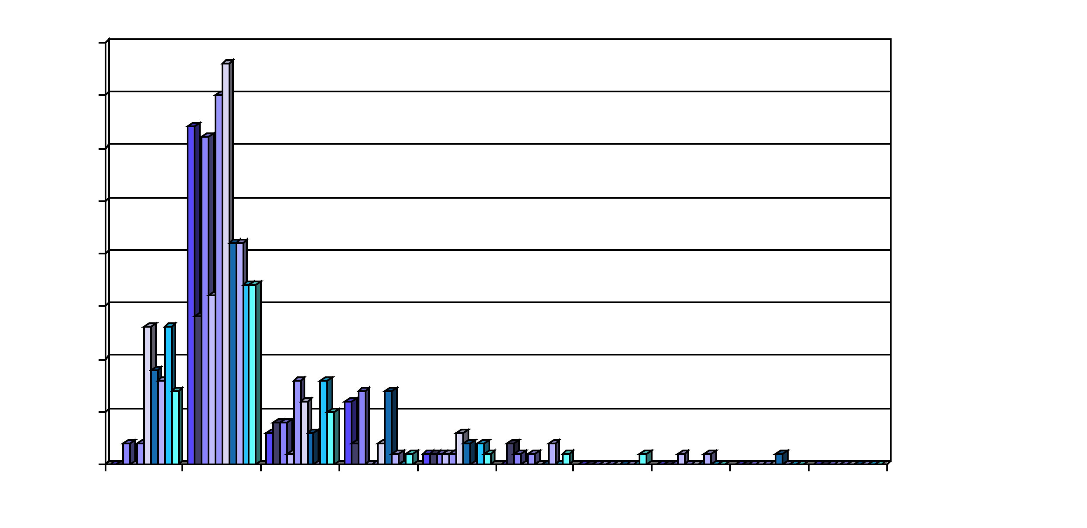
Histograms
A popular data reduction technique
Divide data into buckets and store average (sum) for each bucket
Can be constructed optimally in one dimension using dynamic programming
Related to quantization problems

Slide 29
Clustering
Partition data set into clusters, and one can store cluster representation only
Can have hierarchical clustering and be stored in multi-dimensional index tree structures
There are many choices of clustering definitions and clustering algorithms

Slide 30
Sampling
Complexity
Allow a mining algorithm to run in complexity that is potentially sub-linear to the size of the data
Choose a representative subset of the data
Simple random sampling may have very poor performance in the presence of skew
Develop adaptive sampling methods
Stratified sampling:
Approximate the percentage of each class (or subpopulation of interest) in the overall database
Used in conjunction with skewed data

Slide 31
Sampling
SRSWOR
(simple random
sample without
replacement)
SRSWR
Raw Data

Slide 32
Sampling
Raw Data
Cluster/Stratified Sample

Slide 33
Hierarchical Reduction
Use multi-resolution structure with different degrees of reduction
Hierarchical clustering is often performed but tends to define partitions of data sets rather than “clusters”
Parametric methods are usually not amenable to hierarchical representation
Hierarchical aggregation
An index tree hierarchically divides a data set into partitions by value range of some attributes
Each partition can be considered as a bucket
Thus an index tree with aggregates stored at each node is a hierarchical histogram

Slide 34
Discretisation
Three types of attributes
Nominal — values from an unordered set
Ordinal — values from an ordered set
Continuous — real numbers
Discretisation
divide the range of a continuous attribute into intervals
Some classification algorithms only accept categorical attributes
Reduce data size by discretisation
Prepare for further analysis

Slide 35
Discretisation and Concept hierarchy
Discretisation
reduce the number of values for a given continuous attribute by dividing the range of the attribute into intervals. Interval labels can then be used to replace actual data values
Concept hierarchies
reduce the data by collecting and replacing low level concepts (such as numeric values for the attribute age) by higher level concepts (such as young, middle-aged, or senior).

Slide 36
Discretisation and concept hierarchy generation for numeric data
Binning
Histogram analysis
Clustering analysis
Entropy-based discretisation
Segmentation by natural partitioning

Slide 37
Concept hierarchy generation for categorical data
Specification of a partial ordering of attributes explicitly at the schema level by users or experts
Specification of a portion of a hierarchy by explicit data grouping
Specification of a set of attributes, but not of their partial ordering
Specification of only a partial set of attributes

Slide 38
Specification of a set of attributes
Concept hierarchy can be automatically generated based on the number of distinct values per attribute in the given attribute set. The attribute with the most distinct values is placed at the lowest level of the hierarchy.
country
15 distinct values
province_or_ state
65 distinct values
city
3567 distinct values
street
674,339 distinct values

